Slide 1
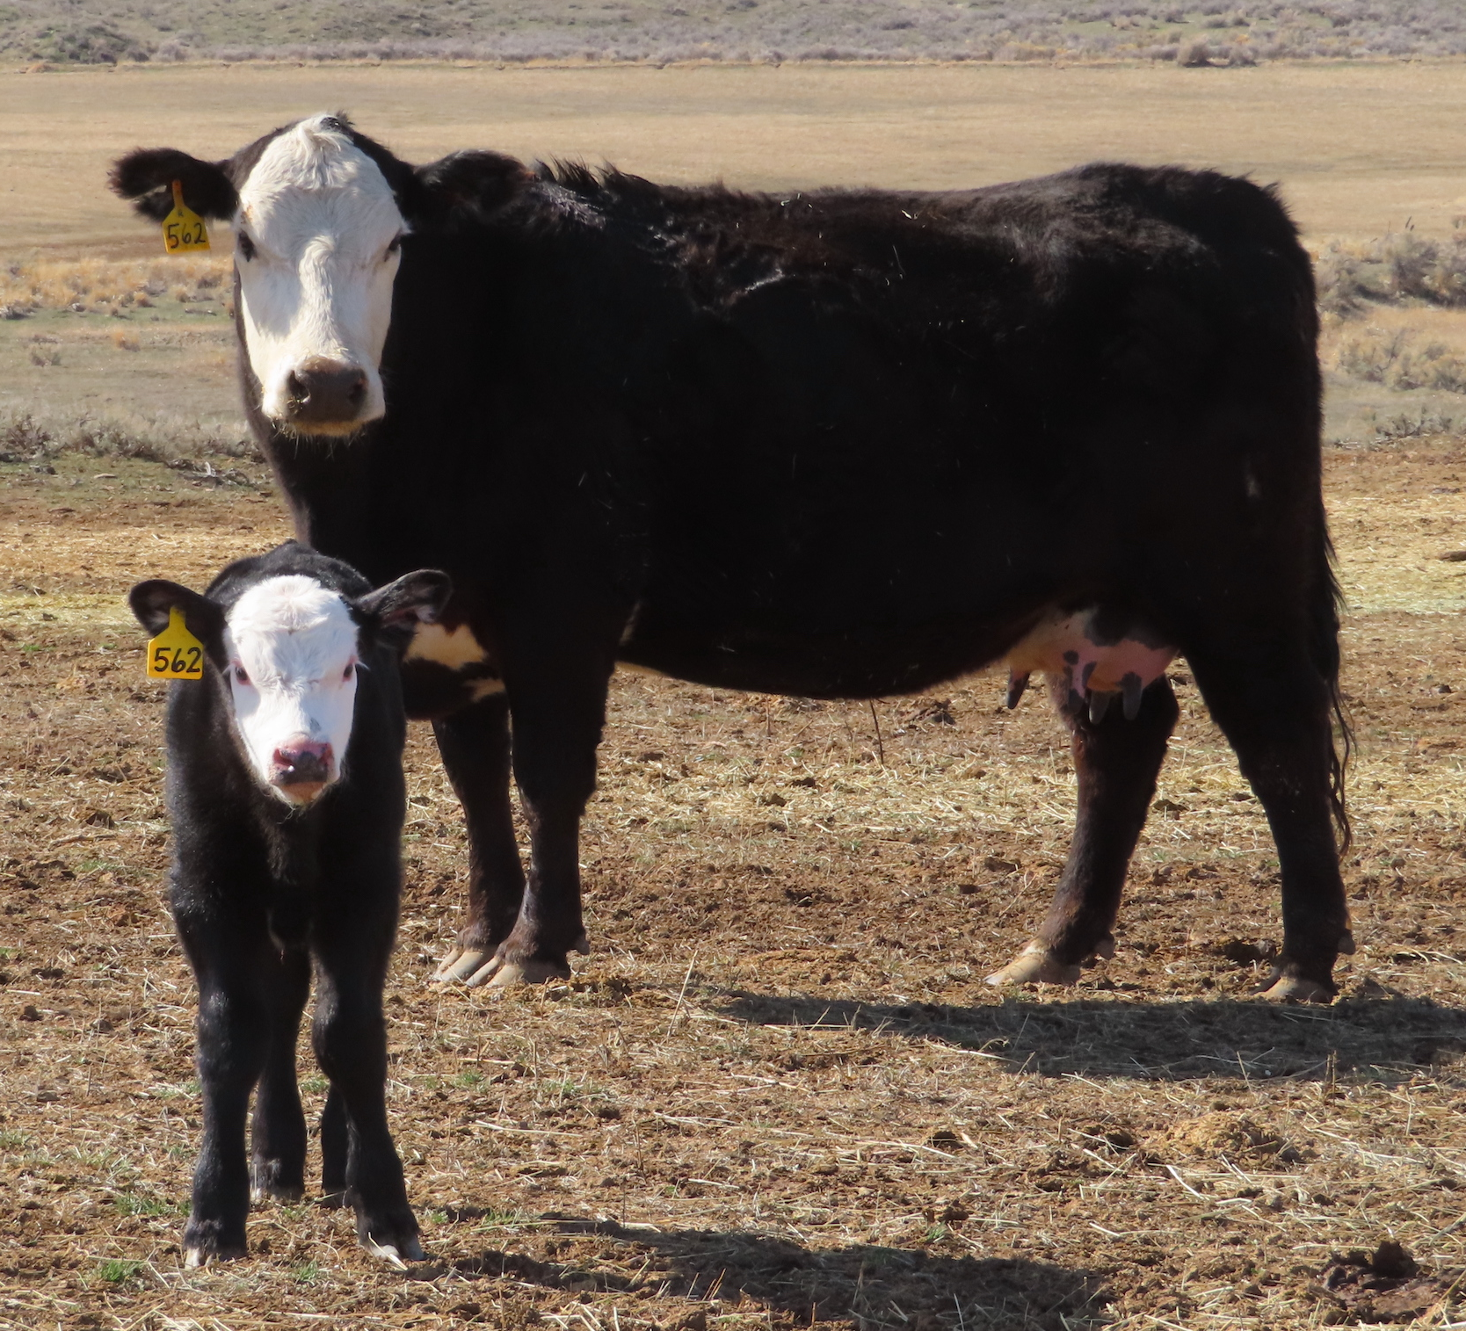
County Livestock Loss Authority
Compensation Policy
May 2026
Notes:
Livestock are cattle, horses, mules, sheep, lamb, swine and livestock guardian dogs

Slide 2
County Livestock Loss Authority
The Boards of County Commissioners of Catron, Sierra, and Socorro County formed the County Livestock Loss Authority (CLLA) in 2023 to compensate livestock producers for the disproportionate impacts on their operations from reintroduction of the Mexican wolf through the Mexican Wolf Recovery Program.
Although formed by the three Counties, payments are available to livestock producers regardless of location in New Mexico. The CLLA’s ability to compensate for losses is subject to the availability of funding, which we continue to work aggressively to increase both at the New Mexico State Legislature and through Congress.
The CLLA has made substantial strides in providing compensation to livestock producers for Mexican wolf kills and injuries to their livestock in a timely manner. In 2026, CLLA expanded its jurisdiction to cover losses from grey wolf depredations in New Mexico as well. The following compensation policy outlines the CLLA Board’s stance on what claims may be considered for compensation and the needed documentation to process that claim.

Slide 3
Compensation Program
Depredation investigators associated with USDA-APHIS Wildlife Services must conduct the investigation and issue a report. For compensation, the depredation must be “Confirmed Mexican Wolf” or “Probable Mexican Wolf”. The same requirement applies to grey wolf depredations.
The compensation provided will be 100 percent FMV (fair market value) for cattle and sheep. CLLA posts the current quarterly Market Value Report on the website: https://cllanm.org/applications-docs/ The FMV used corresponds with the date the depredation occurred.
The investigation “Depredation Report” must be provided with all depredation compensation claims. That report, along with a completed CLLA application and a completed Federal W-9 must be provided to the CLLA Administrator to process payment.
For horse/mule or other equine related confirmed or probable depredation claims, the CLLA Board must review the claim. **see pg. 5 for equine related claims**

Slide 4
Compensation Program cont.
CLLA reviews each claim for injury expenses. CLLA policy is to compensate for injury claims that include licensed veterinary care, medication, travel expenses for mileage to veterinarian services or the veterinarian’s ranch call fees. CLLA does not compensate for claims for labor and/or feed for injured animals. **Receipts must accompany the claim**
Payments for injury claims that exceed the quarterly FMV of the animal will not be considered without accompanying documentation.
CLLA reviews any claim requests for depredation or injury compensation for livestock values that exceed the quarterly FMV and provided documentation.

Slide 5
Compensation Program cont.
Equine claim compensation is dependent on the use of the animal. Ranch horse/mule compensation is capped at $10,000.00. Performance horse/mule compensation is capped at $16,000.00. Documentation of competition history is required for the performance valuation. CLLA determines the applicable compensation based on provided information from the claim.
Commercial bulls will be compensated on a sliding depreciation scale based on age if the claim exceeds the FMV of the quarter when the depredation occurred with a base of cull value.
Documented confirmed or probable depredation injured calves that sell at a reduced market value at a livestock sale may be the subject of a compensation claim. The producer will need to provide the comparable calf sale prices for the injured calf.

